Slide 1
Computer Graphics in Gaming
Rachel Agner, John MacAslan, Hayley Price
Software Quality Assurance, Dr. Sriram Mohan
Rose-Hulman Institute of Technology
10 May 2013

Slide 2


Quality in Game Graphics
Visual aesthetic
Resolution
Performance

Slide 3
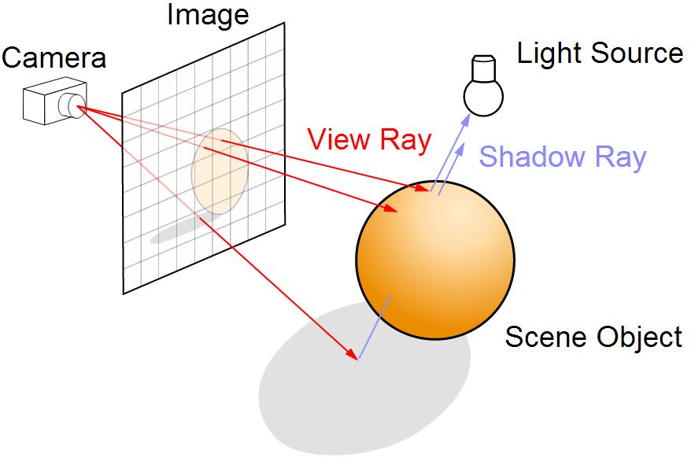
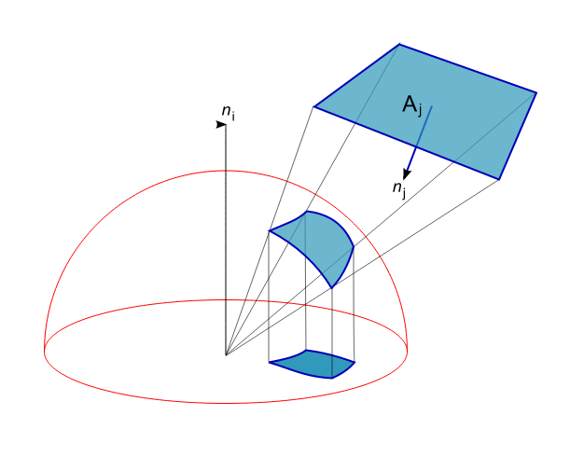
Key Factors
Rendering Algorithms
Ray tracing
Radiosity
Hardware
Ray Tracing
Radiosity

Slide 4
Processes
Tracking resolution and frame rate
Customer feedback
Beta releases

Slide 5
Common Problems
Varying user opinions
Unpredictability of user platform

Slide 6
Currently Used Metrics
Customer satisfaction
Traffic
Peak Traffic
How often a given user is playing
Duration of single game session
User base growth
Fix response time
Fix backlog
Fix Quality
% Delinquent fixes

Slide 7
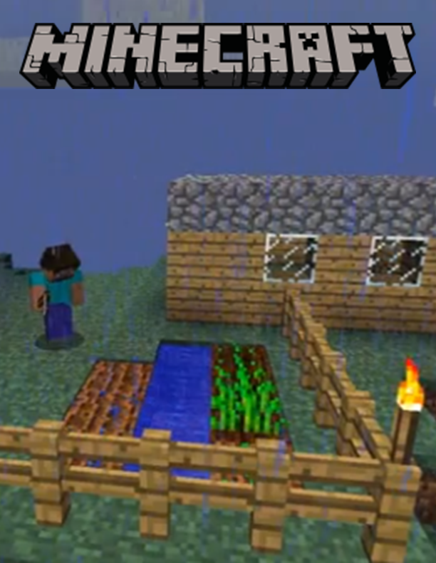

Successes

Slide 8

Failures

